Slide 1

Let's create and host our first responsive website !!
Realized by:
Machfar Mohamed Souhayel
February 2021

Slide 2
What are we going to do today?
Web development Fundamentals
HTML5, CSS3, Javascript
Types of web developers
Dynamic vs static website
Introduction
What is Responsive web design ?
How can we use it ?
Responsive web design
Project overview
Environment setup
Creating the website from scratch
Project
Version control system
Git/GitHub

Slide 3
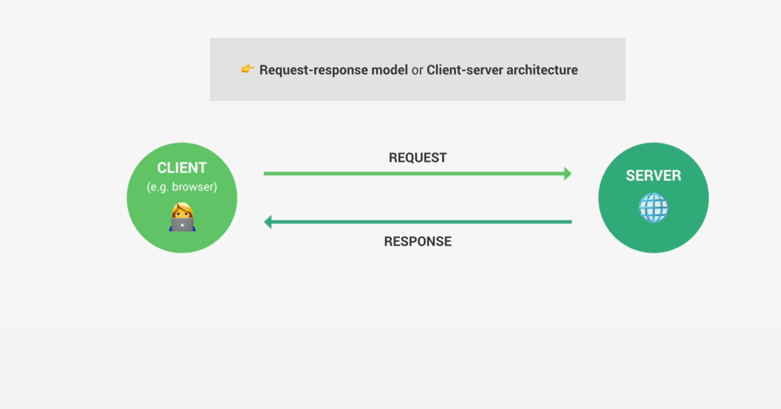
Web development Fundamentals:
Introduction
Responsive Web Design
Project
Version Control System
1

Slide 4
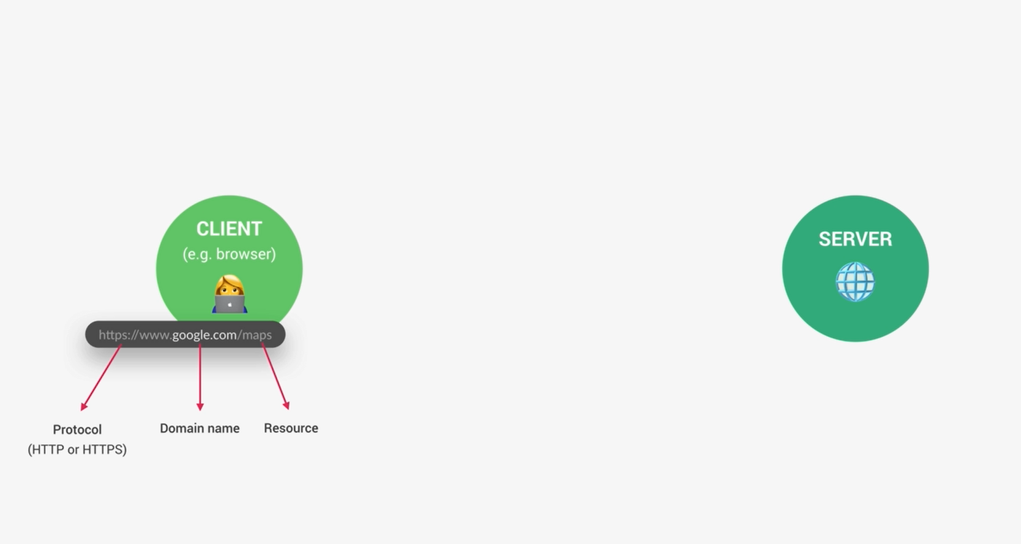
Web development Fundamentals:
Introduction
Responsive Web Design
Project
Version Control System
2

Slide 5
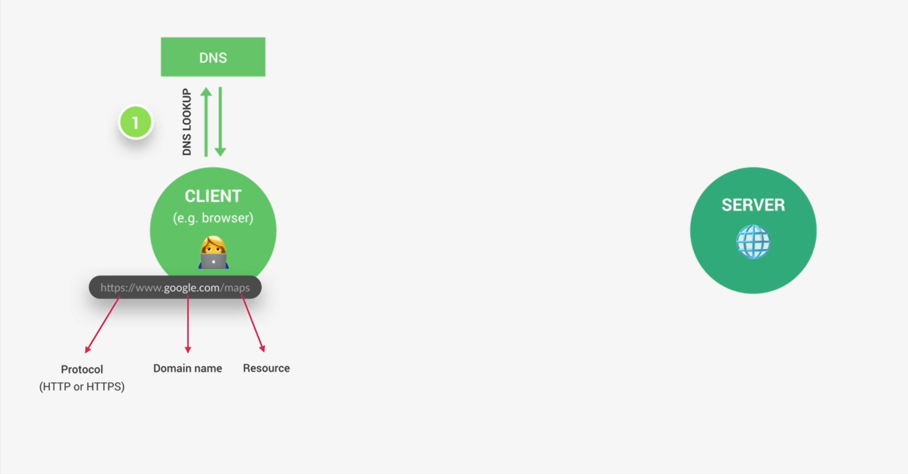
Web development Fundamentals:
Introduction
Responsive Web Design
Project
Version Control System
3

Slide 6
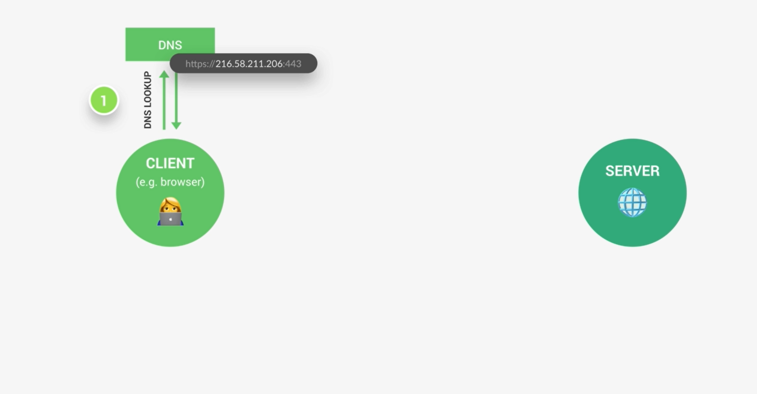
Web development Fundamentals:
Introduction
Responsive Web Design
Project
Version Control System
4

Slide 7
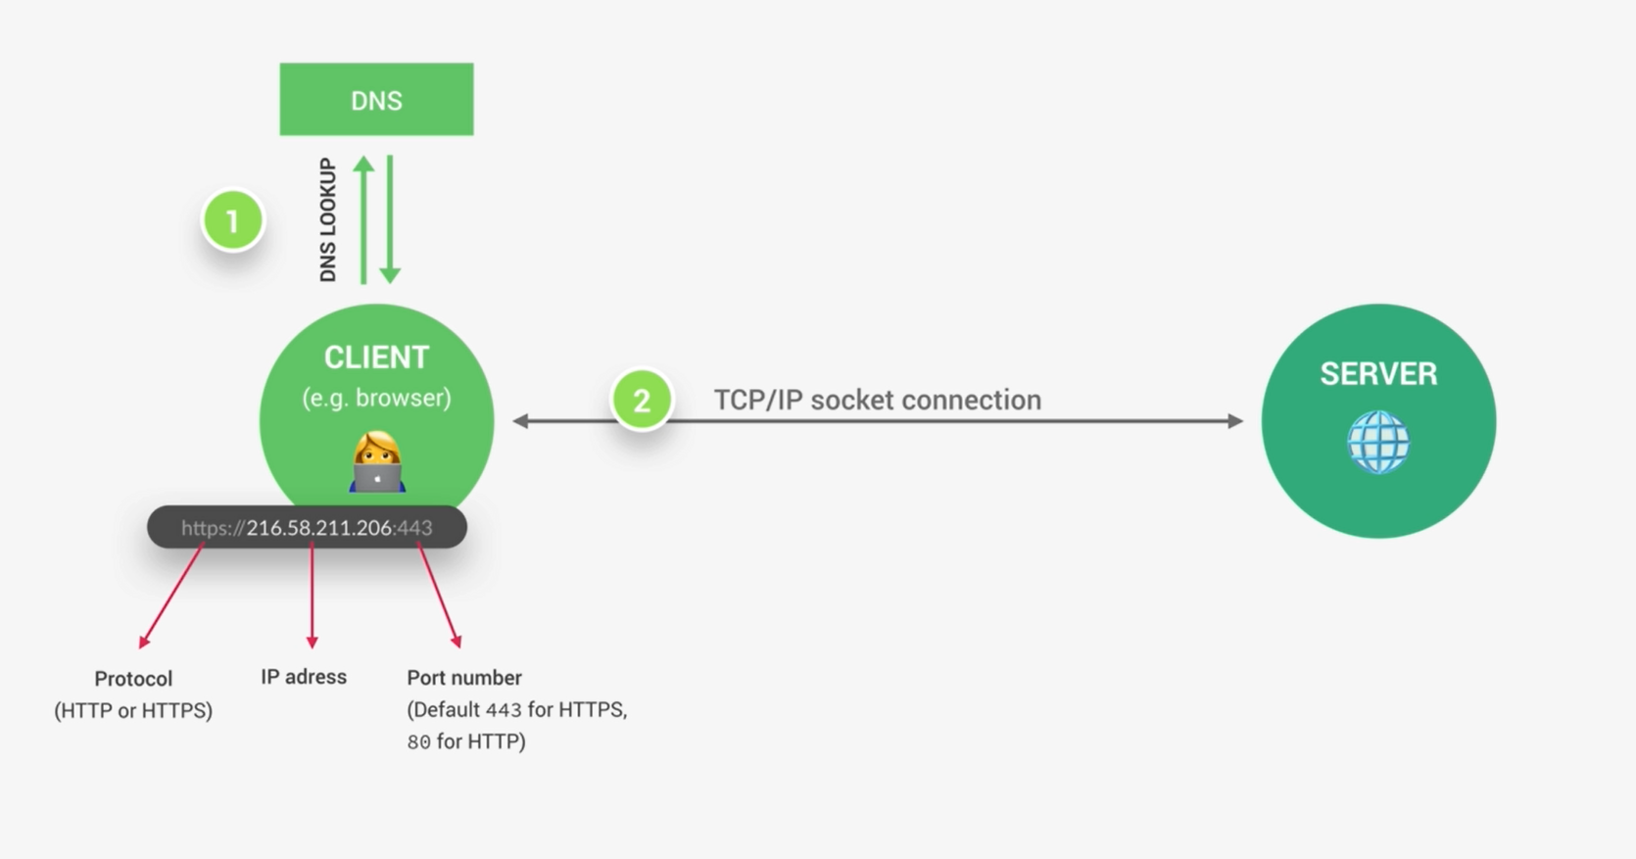
Web development Fundamentals:
Introduction
Responsive Web Design
Project
Version Control System
5

Slide 8
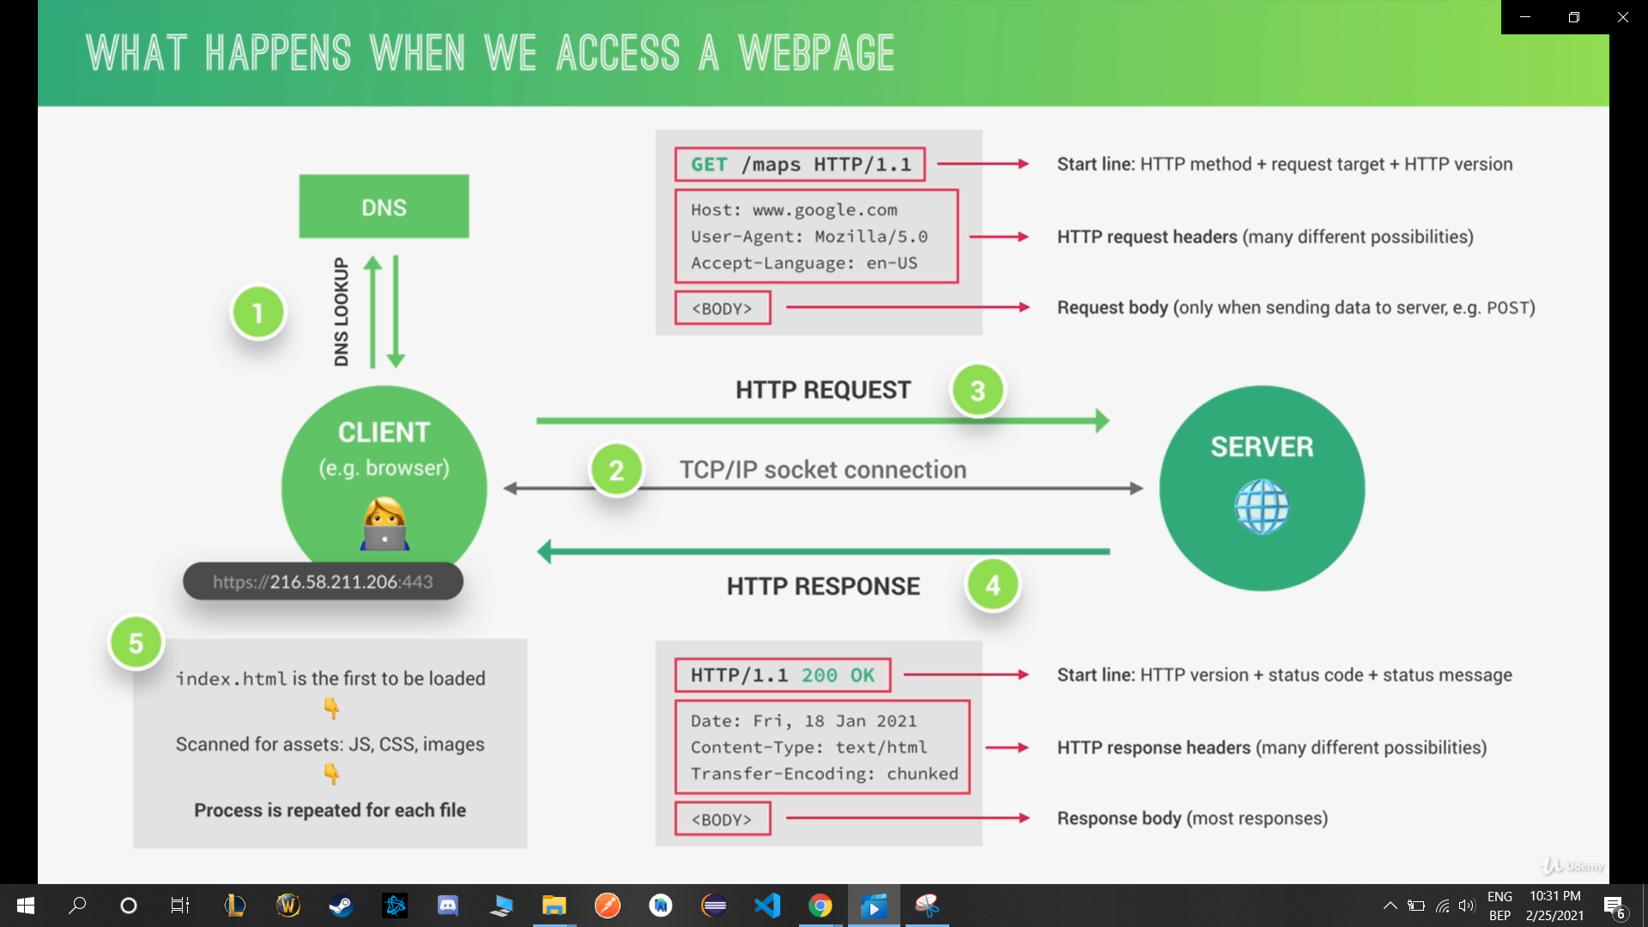
Web development Fundamentals:
Introduction
Responsive Web Design
Project
Version Control System
6

Slide 9
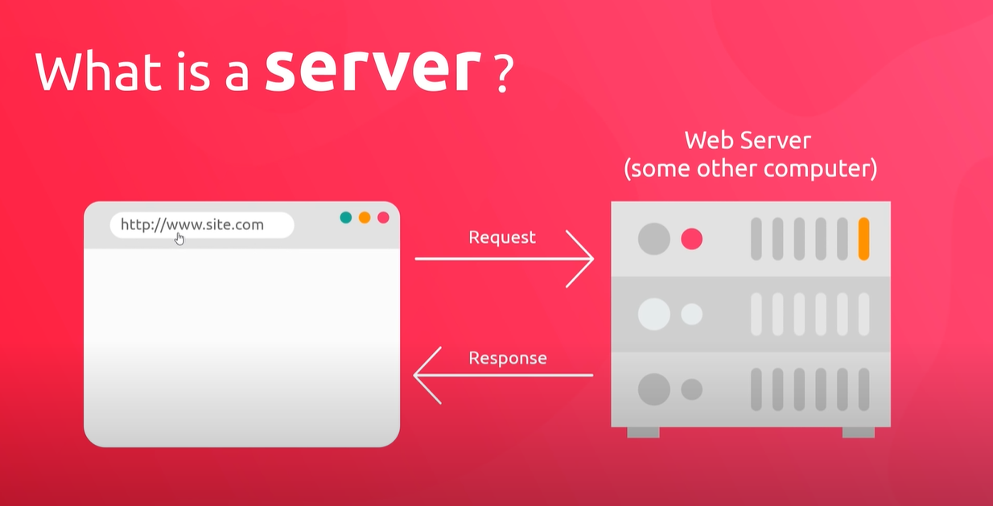
Web development Fundamentals:
Introduction
Responsive Web Design
Project
Version Control System
7

Slide 10
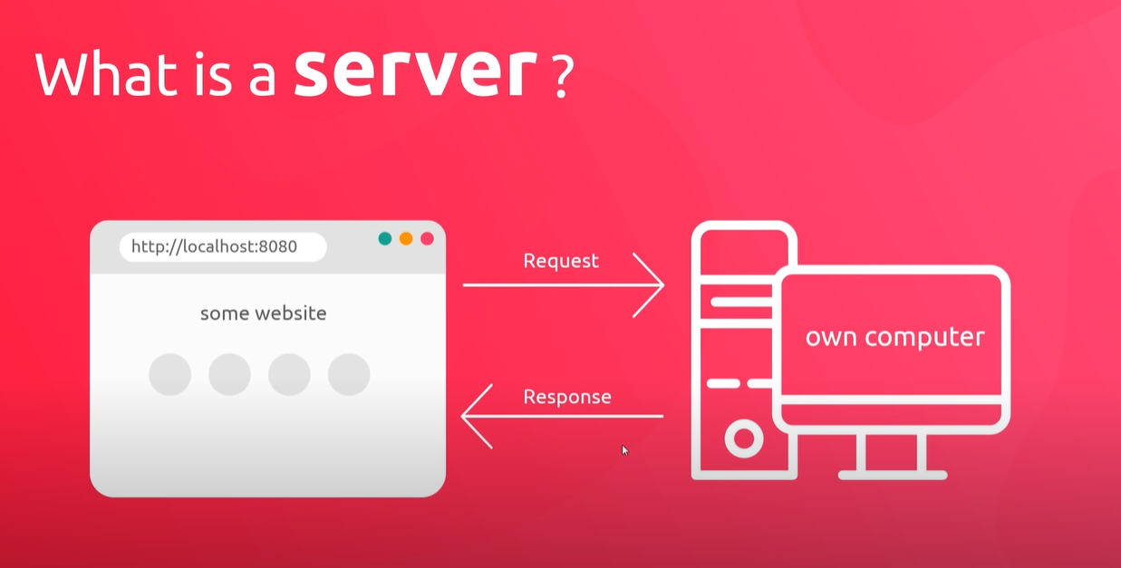
Web development Fundamentals:
Introduction
Responsive Web Design
Project
Version Control System
8

Slide 11
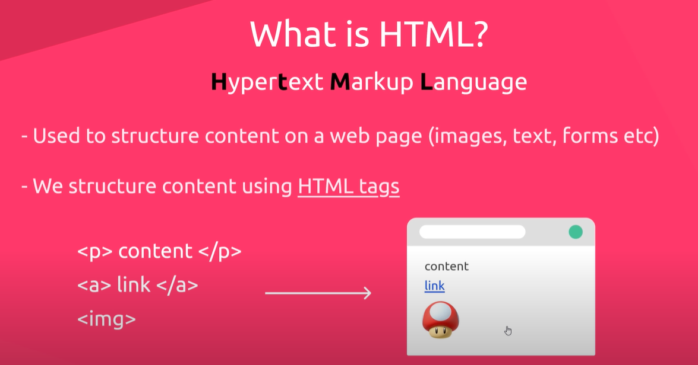
HTML5, CSS3, JavaScript :
Introduction
Responsive Web Design
Project
Version Control System
9

Slide 12
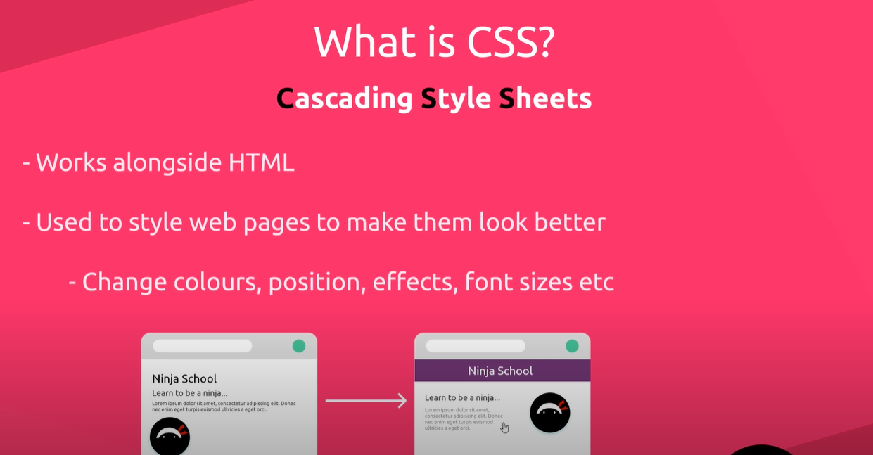
HTML5, CSS3, JavaScript :
Introduction
Responsive Web Design
Project
Version Control System
10

Slide 13
HTML5, CSS3, JavaScript :
Introduction
Responsive Web Design
Project
Version Control System
11

Slide 14
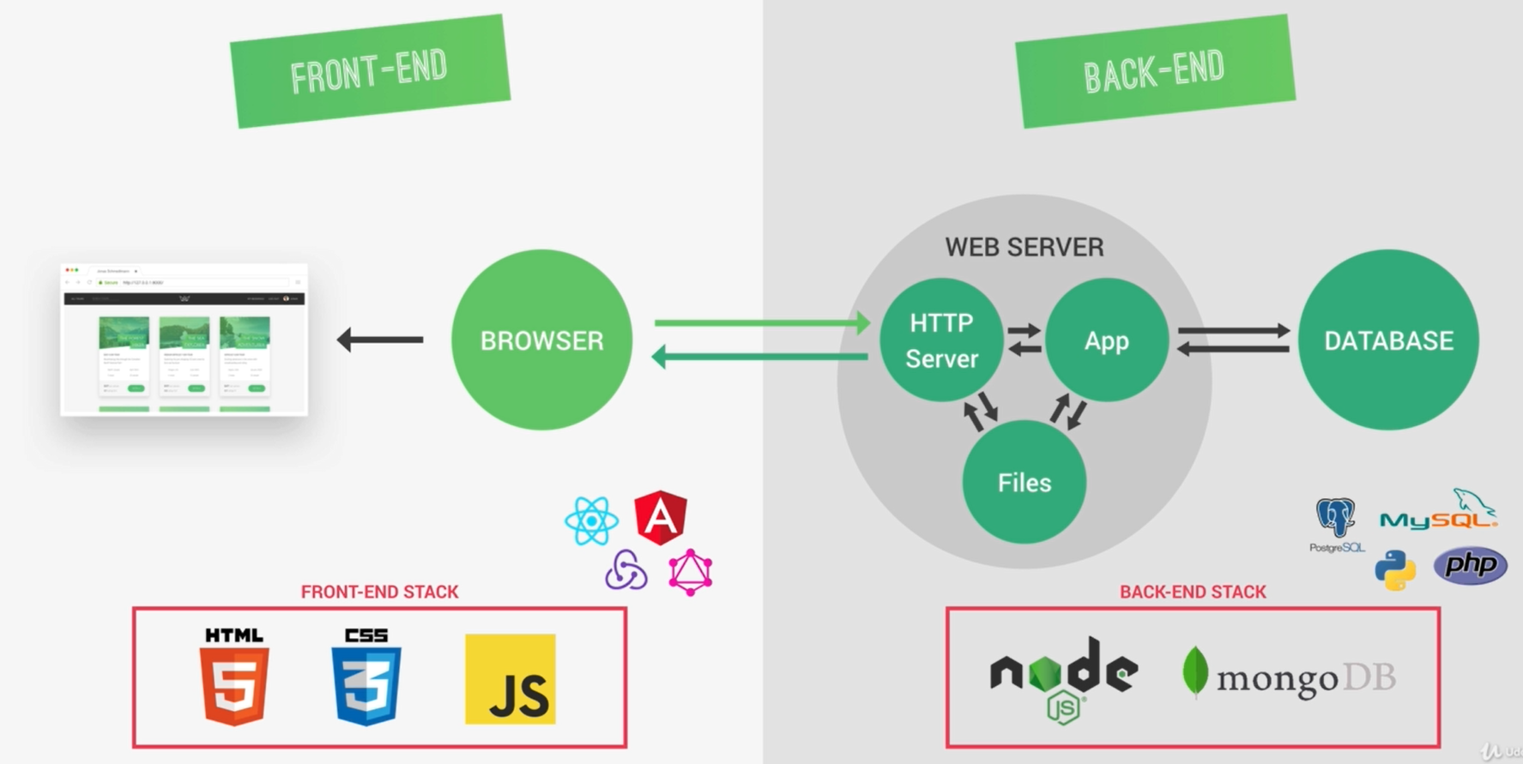
Types of web developers :
Introduction
Responsive Web Design
Project
Version Control System
12

Slide 15
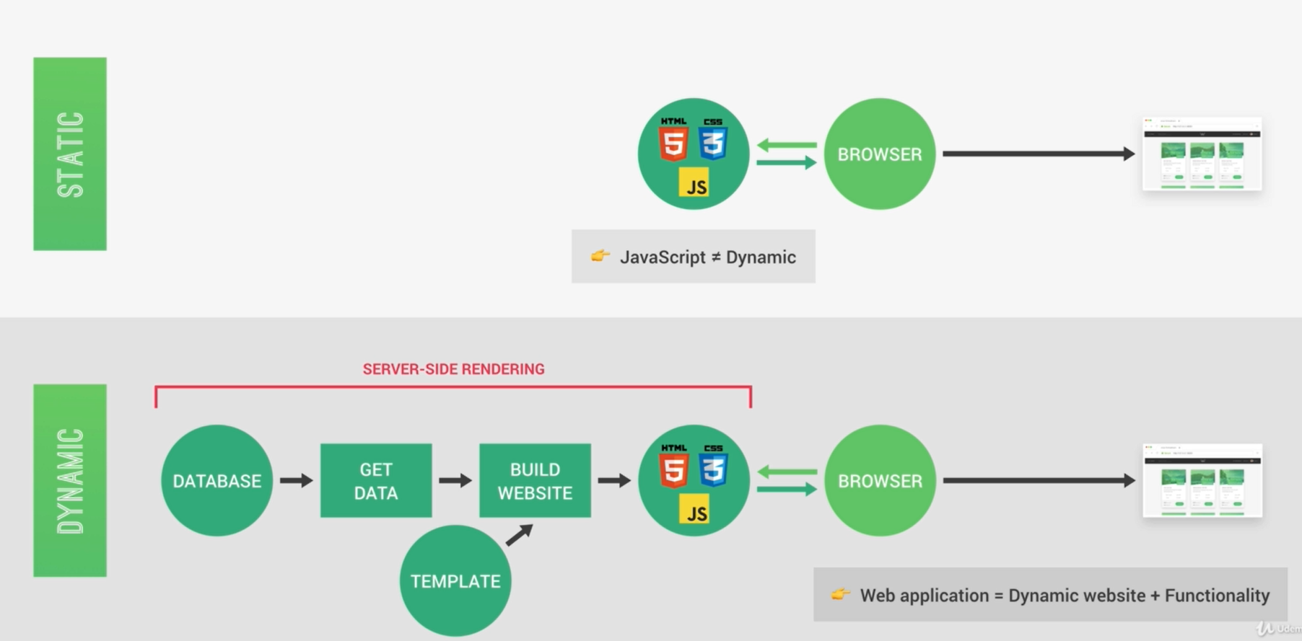
Dynamic vs static website :
Introduction
Responsive Web Design
Project
Version Control System
13

Slide 16

What is Responsive Web Design?
Responsive Web Design
Introduction
Project
Version Control System
14

Slide 17

Responsive web design makes your web page look good on all devices.
Responsive web design uses only HTML and CSS.
Responsive web design is not a program or a JavaScript.
Responsive Web Design
Introduction
Project
Version Control System
15

Slide 18
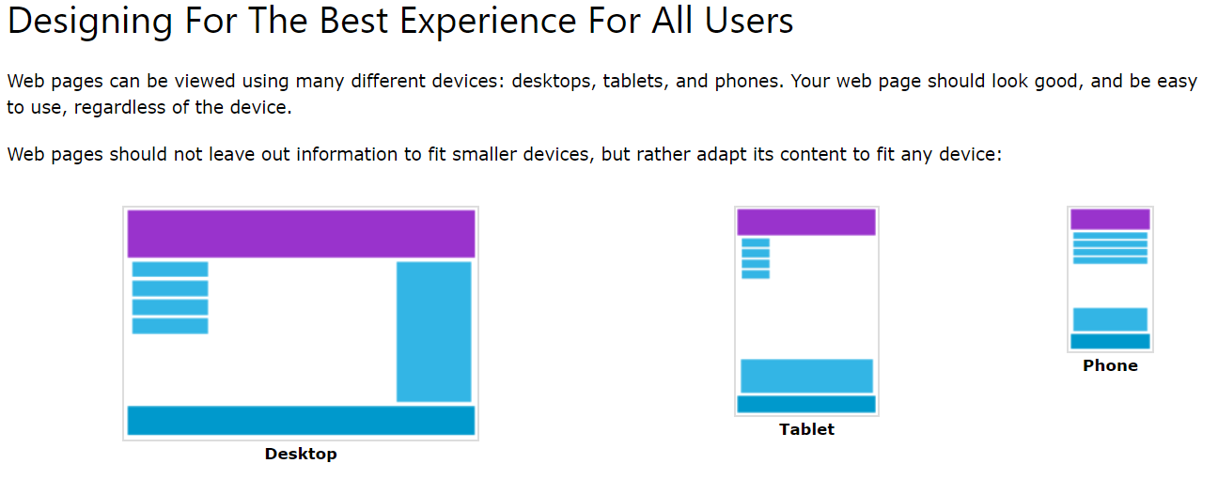
Designing for the best experience for all users:
Web pages can be viewed using many different devices: Desktops, tablets and Phones.
Your Web page should look good, and easy to use, regardless of the device.
Web pages should not leave out information to fit smaller devices, but rather adapt its content to fit any device:
Responsive Web Design
Introduction
Project
Version Control System
16

Slide 19
How can we use it?
Responsive Web Design
Introduction
Project
Version Control System
17

Slide 20
Setting The Viewport
<meta name="viewport" content="width=device-width, initial-scale=1.0">
This gives the browser instructions on how to control the page's dimensions and scaling.
The width=device-width part sets the width of the page to follow the screen-width of the device (which will vary depending on the device).
The initial-scale=1.0 part sets the initial zoom level when the page is first loaded by the browser.
What is a Media Query?
Media query is a CSS technique introduced in CSS3.
It uses the @media rule to include a block of CSS properties only if a certain condition is true.
@media only screen and (max-width: 600px) {
body {
background-color: lightblue;
}
}
Responsive Web Design
Introduction
Project
Version Control System
18

Slide 21
Project overview
Environment setup
Creating the website from scratch
Project
Introduction
Responsive Web Design
Version Control System
19

Slide 22
Git/ GitHub:
Version Control System
Introduction
Responsive Web Design
Project
20

Slide 23
Version Control System
Introduction
Responsive Web Design
Project
21

